Slide 1


POWER BI

Slide 2
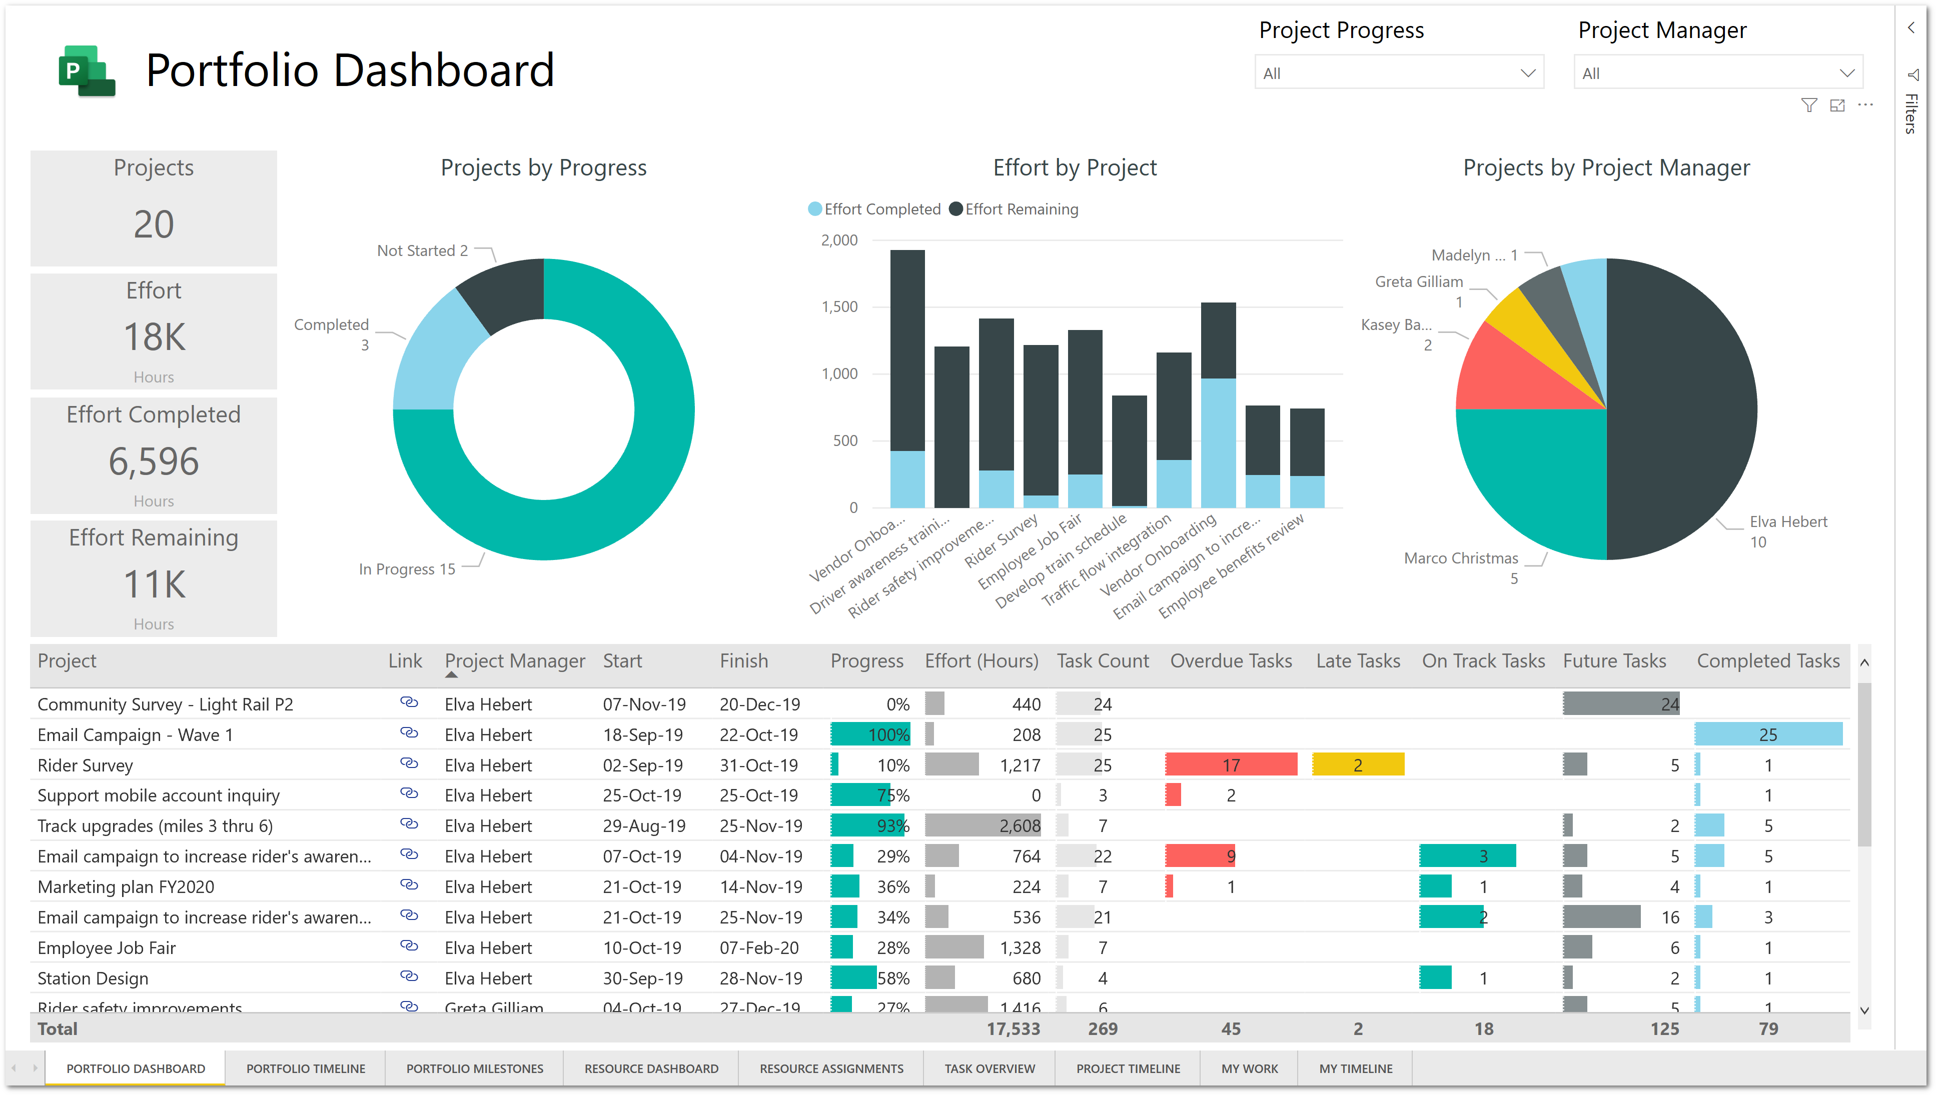
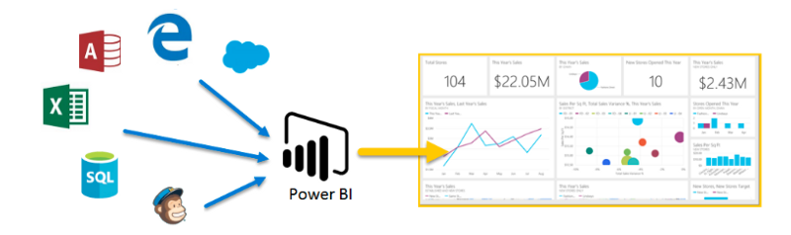
What is Power BI
Power BI is a data analytics tool provided by Microsoft Power BI gives the ability to analyze and explore data on-premise as well as in the cloud.
It provides interactive visualizations with intelligence capabilities, where users can use to create reports and dashboards by themselves, without having to depend on information technology staff or database administrators.
Power BI provides the ability to collaborate and share customized dashboards and interactive reports across colleagues and organizations, easily and securely.

Slide 3
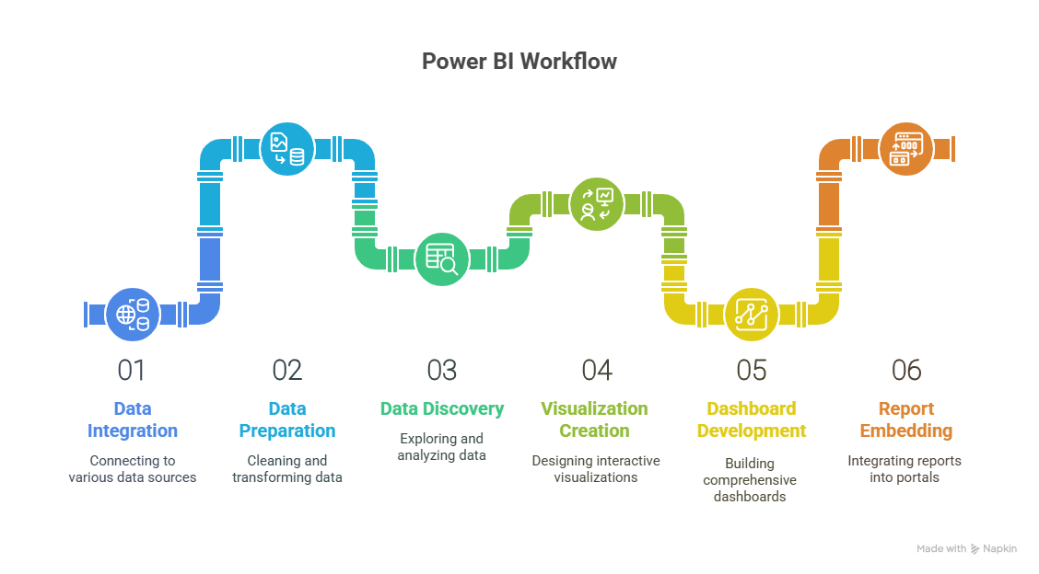

Slide 4
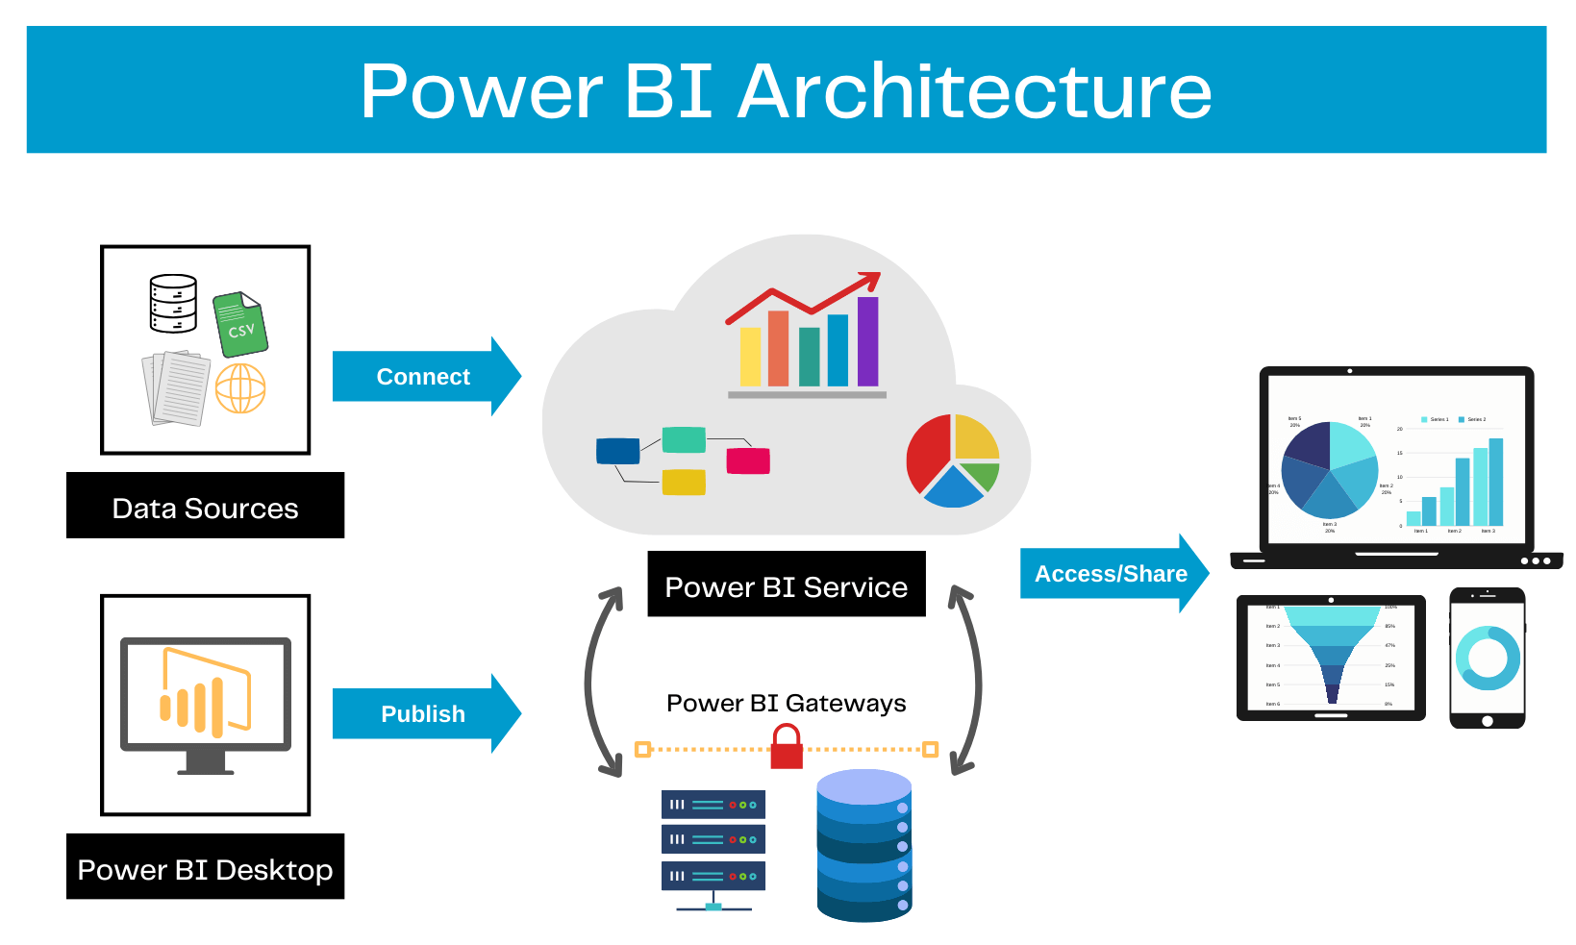

Slide 5
Usage of Data Analysis in Industry:
E-commerce Industry
Usage: Customer behavior analysis and personalized marketing.
Example: E-commerce companies use data analysis to track user browsing and purchase history, enabling personalized product recommendations and targeted advertisements that increase conversion rates.
Healthcare Industry
Usage: Predictive analytics to improve patient care.
Example: Hospitals analyze patient records and historical data to predict the likelihood of readmission or potential health risks, enabling early intervention and personalized treatment plans.
Finance Industry
Usage: Risk assessment and fraud detection.
Example: Banks use data analysis to detect unusual spending behavior that may indicate fraud, and to assess credit risk before approving loans or credit cards.

Slide 6
Evolution of Power BI
Early Beginnings (2009-2013)
Initially developed as add-ons in Excel.
Microsoft recognized the demand for a standalone BI tool.
Introduction as a Separate Product (2015)
Power BI was launched as a cloud-based BI tool.
Included Power BI Desktop, Power BI Service, and Power BI Mobile.
AI & Advanced Analytics (2017-2020)
Integration of Artificial Intelligence (AI) for data insights.
Enhanced data connectivity with Azure, SQL Server, and third-party sources.
Real-time & Hybrid Analytics (2021-Present)
Enhanced real-time data processing capabilities.
Improved collaboration with Microsoft Teams and Excel.
Expanded governance and security.

Slide 7
Why Power BI ?
In today’s data-driven world, businesses generate massive amounts of data. Business Intelligence (BI) is essential to transform raw data into meaningful insights for better decision-making.
Why Do Businesses Need BI?
✅ Data-Driven Decision Making – Helps organizations make informed and strategic decisions.
✅ Improved Efficiency – Automates data collection, reporting, and analysis, saving time and resources.
✅ Better Customer Insights – Analyzes customer behavior, trends, and preferences for personalized experiences.
✅ Competitive Advantage – Identifies market trends, risks, and opportunities to stay ahead of competitors.
✅ Cost Optimization – Identifies inefficiencies and areas to reduce operational costs.

Slide 8
Benefits of Power BI
Integrates seamlessly with different data sources.
Rich personalized dashboards.
Provides a cloud-based as well as a desktop interface.
Publish reports securely over web and mobile apps
Export to different format like PDF and PPT
Integrated with different web applications and SharePoint applications
Easily scalable across the entire organization.

Slide 9
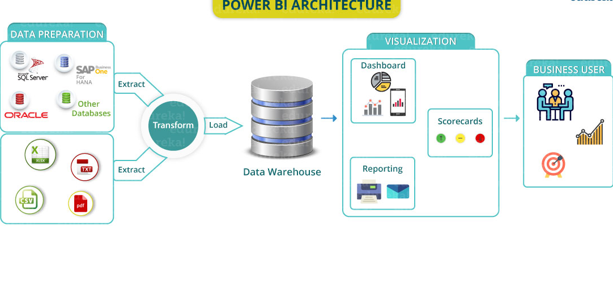
Power BI Consists of Four Components/Phases
Data Sources Components | Data Transformation | Data Visualization | Publishing & Sharing
Power BI Applications
Power BI Desktop | Power BI Web | Power BI Mobile

Slide 10
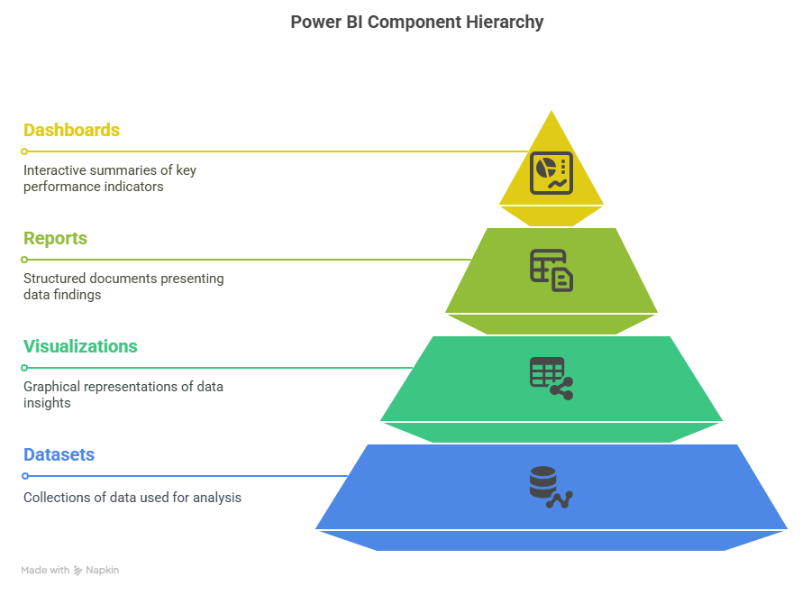
BUILDING BLOCKS / COMPONENTS OF POWER BI
Everything you do in Power BI can be broken down into following building blocks. A good understanding of these building blocks would help you understand concepts and will let you create detailed and complex reports.
The basic building blocks/components of Power BI are the following:
Visualizations
Datasets
Reports
Dashboards

Slide 11
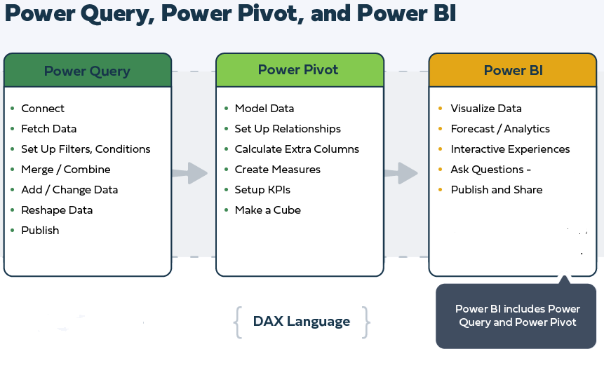
Power BI

Slide 12
Components of Power BI
Data Sources Components | Data Transformation | Data Visualization | Publishing & Sharing
Files Sources Database Sources Analytical Sources Azure Sources Web Sources Other Sources (SalesForce, Dynamics etc) | Remove Rows Filter Data Remove Columns Split Columns Merge Columns Add Columns | Bar Charts Pie Chart Funnel TreeMap Maps Table Matrix | Power BI Web Sharing PBIX file Export to PDF Export to PPT Power BI Mobile Views

Slide 13
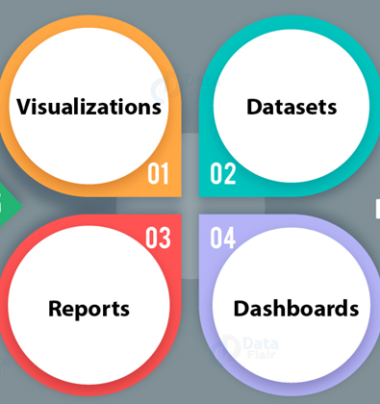
Building blocks of Power BI (Major block of Power BI Reporting)
Power BI

Slide 14
Dataset:
Data-set is nothing but a collection of data or information.
Power BI harnesses this data to create visualizations.
It can be a simple data set or a combination of many different sources, which can be filtered and combined to provide a different data set altogether.

Slide 15
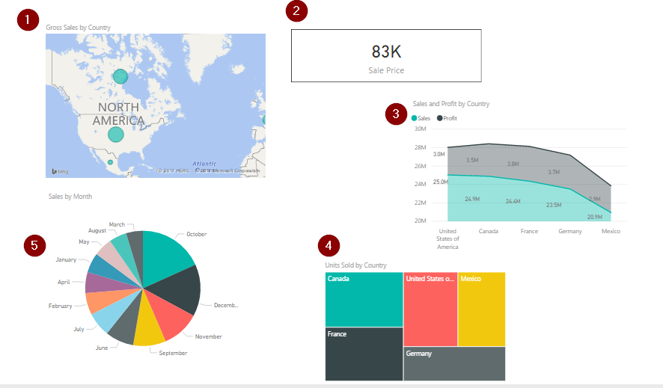
Visualizations: A visual representation of data is called visualization. For example, a chart or a graph can be used to represent data visually.
1.Map representation
2.Card visualization
3.Stacked area chart
4.Tree map
5.Pie chart

Slide 16
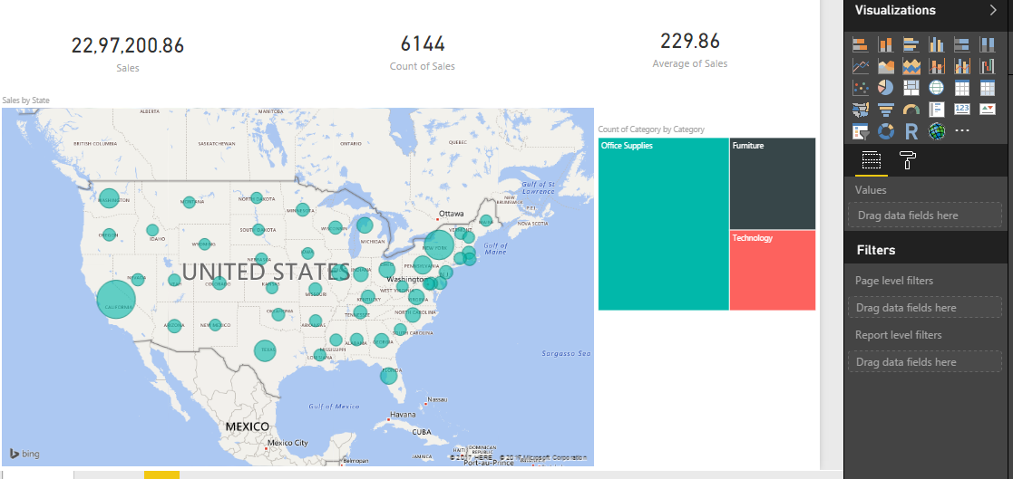
Reports: A collection of visualizations that appear together on one or more pages is a report in Power BI. It is a collection of items that are related to one another.

Slide 17
Dashboards: A Power BI dashboard is a single page interface. It is often called a canvas, that uses visualizations to tell a story.

Slide 18
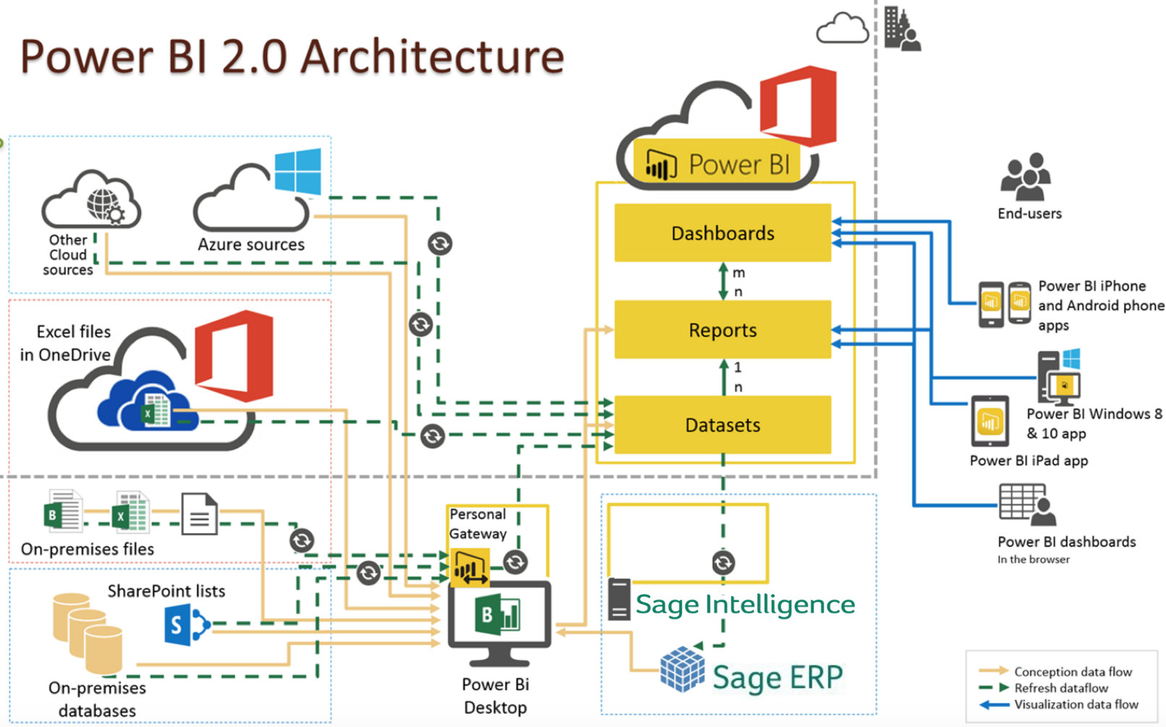
Architecture

